Slide 1
BA DIEM HIGH SCHOOL
UNIT 13: FILMS AND CINEMA
LISTENING
Instructor: NGUYỄN HOÀNG ANH
Class: 10A11

Slide 2
REVISION
WORK IN GROUPS
Fill the blank with the appropriate form of words
1. It was not until 1915 that the cinema _______ became an industry. (real)
2. Since 1950s, the cinema has developed ______. (rapid)
3. Which do you _______ detective films or science fiction films? (preference)
4. This is the most ______ race that I’ve ever taken part in. (thrill)
5. The cinema or the motion picture is one of the most popular forms of _______. (entertain)

Slide 3
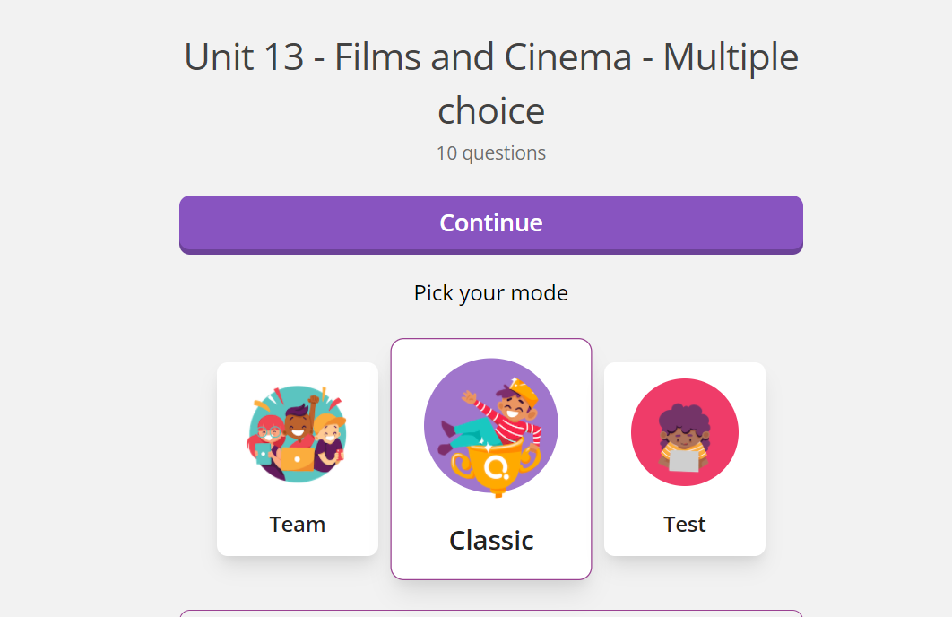
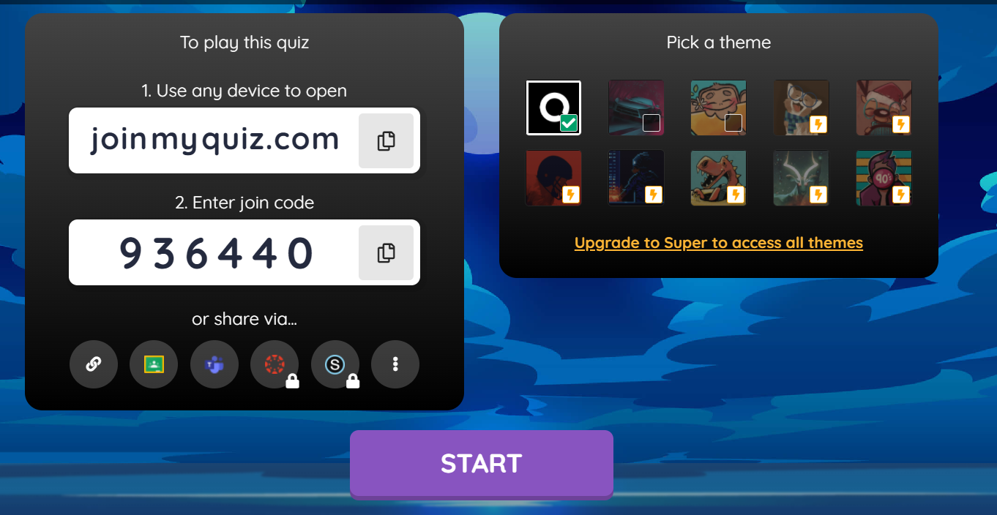
MINI-GAME
WORK IN GROUPS
227947

Slide 4
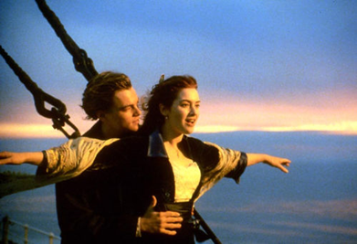
1. Have you ever seen the film Titanic?
2. Name two main characters in this film.
3. What do you learn after watching Titanic?
1. Yes, I have / No, I haven’t
2. Jack (Leonardo DiCaprio) and Rose (Kate Winslet)
3. Sweet love and lofty sacrifice

Slide 5
New Words
WORK IN PAIRS
1. instead (adv) = in place of someone/ something else
E.g.: We should go to the cinema instead.
2. to suppose /s@"p@Uz/ (v)
= to think that something is likely to be true
supposition (n) = an idea that something may be true
3. to guess (v) = to give the correct answer
4. Titanic (n) /taI"t{nIk/

Slide 6
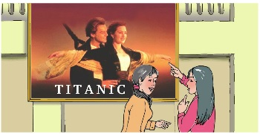
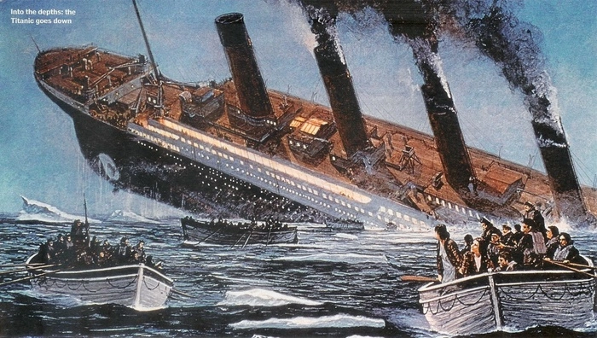
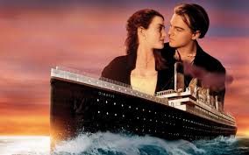
Listen to the dialogue and answer the question:
What are Lan and Huong planning to do together?

Slide 7
Listen to the dialogue again.
Write their plans for the next week on the calendar
 | Lan | Huong
Mon
Tue
Wed
Thu
Fri
Sat
Sun
see a play
work and go to the singing club
visit grandparents
study Chinese
work (busy)
go on a picnic

Slide 8
DISCUSSION
WORK IN GROUPS
LUCKY BOX

Slide 9
CONSOLIDATION
WORK IN PAIRS
Talk about the plan and how to set up a plan
SAMPLE 1
A: What are you planning to do this weekend?
B: I am going _________________ on Saturday.
A: What about Sunday? Are you free on Sunday?
B: Yes, I’m free the whole Sunday.
A: Let’s ______________.
B: Ok! That’s a good idea!
SAMPLE 2
A: Have you got anything special this weekend?
B: I intend to _________________ on Saturday.
A: What about Sunday? Are you free on Sunday?
B: Yes, I’m free the whole Sunday.
A: Shall we ______________.
B: Ok! That sounds great!

Slide 10
THANK YOU
FOR YOUR ATTENTION

Slide 11
1. ON FRIDAY, WHAT IS HUONG GOING TO DO?
A. Take a Chinese class
B. Talk to her Chinese friends
C. Fly to China

Slide 12
2. WHAT IS LAN GOING TO DO ON SUNDAY?
A. Visit grandparents
B. Hang out with friends
C. Have no plan

Slide 13
3. WHO IS PLANNING TO GO TO KARAOKE BAR?
A. LAN
B. HUONG
C. NO ONE

Slide 14
4. ON WHAT DAY ARE THEY GOING TO SEE TITANIC FILM?
A. Thursday
B. Tuesday
C. Saturday

Slide 15
5. HOW MANY DAYS A WEEK ARE THEY FREE?
A. 3 days
B. 4 days
C. 5 days

